Slide 1

Class, Objects, Inheritance, and UML
A brief Journey of information

Slide 2
What is a Class?
class: A class is a bleuprint for creating different objects which defines it's properties and behaviors .It can contain fields and methods to describe the behavior of an object .
What is an object?
Object :Object refers to a particular instance of class where the object can be a combination of variables, function and data structures. An object has the same relationship to a class that a variable has to a data type . An object is said to be an instance of class , in the same way 'ME' and 'YOU' are the instance of class 'HUMAN'.
What is inheritance?
Inheritance: Inheritance allows you to define a very general class and then later define more specialized classes that add some new details to the existing general class definition. This saves work, because the more specialized class inherits all the properties of the general class and you, the programmer, need only program the new features.

Slide 3
public class Person
{
private String name;
public Person()
{
name = "";
}
public void setName(String newName)
{
name = newName;
}
public String getName()
{
return name;
}
public void writeOutput()
{
System.out.println("Name: " +
name);
}
}
public class Student extends Person
{
​
private int studentNumber;
public Student()
{
super();
studentNumber = 0;
}
}
public void reset(String newName, int newStudentNumber)
{
setName(newName);
studentNumber = newStudentNumber;
}
public int getStudentNumber()
{
return studentNumber;
}
public void setStudentNumber(int newStudentNumber)
{
studentNumber = newStudentNumber;
}
public void writeOutput()
{
System.out.println("Name: " + getName());
System.out.println("Student Number: " + studentNumber);
}
}

Slide 4

Object Explaination
public class inheritanceDemo
{
public static void main (String[]args)
{
Student s = new Student();
s.setName("Amine");
s.setStudentNumber(7);
s.writeOutput();
}
}

Slide 5
What is UML
UML means Universal Modeling Language (Wikipedia is wrong!)
UML diagrams are used to clearly identify concepts in Object Oriented programming languages. Java, C++, and Python to name a few.

Slide 6
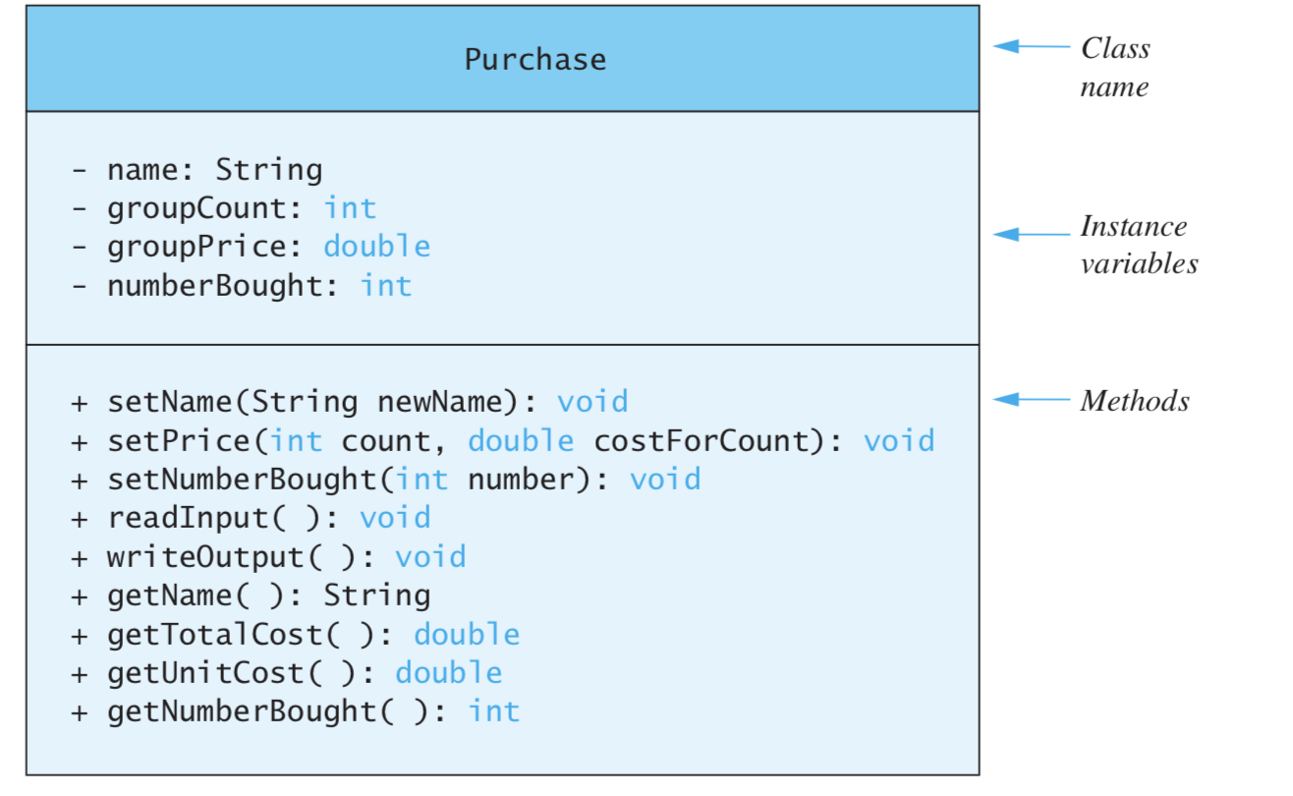
UML

Slide 7
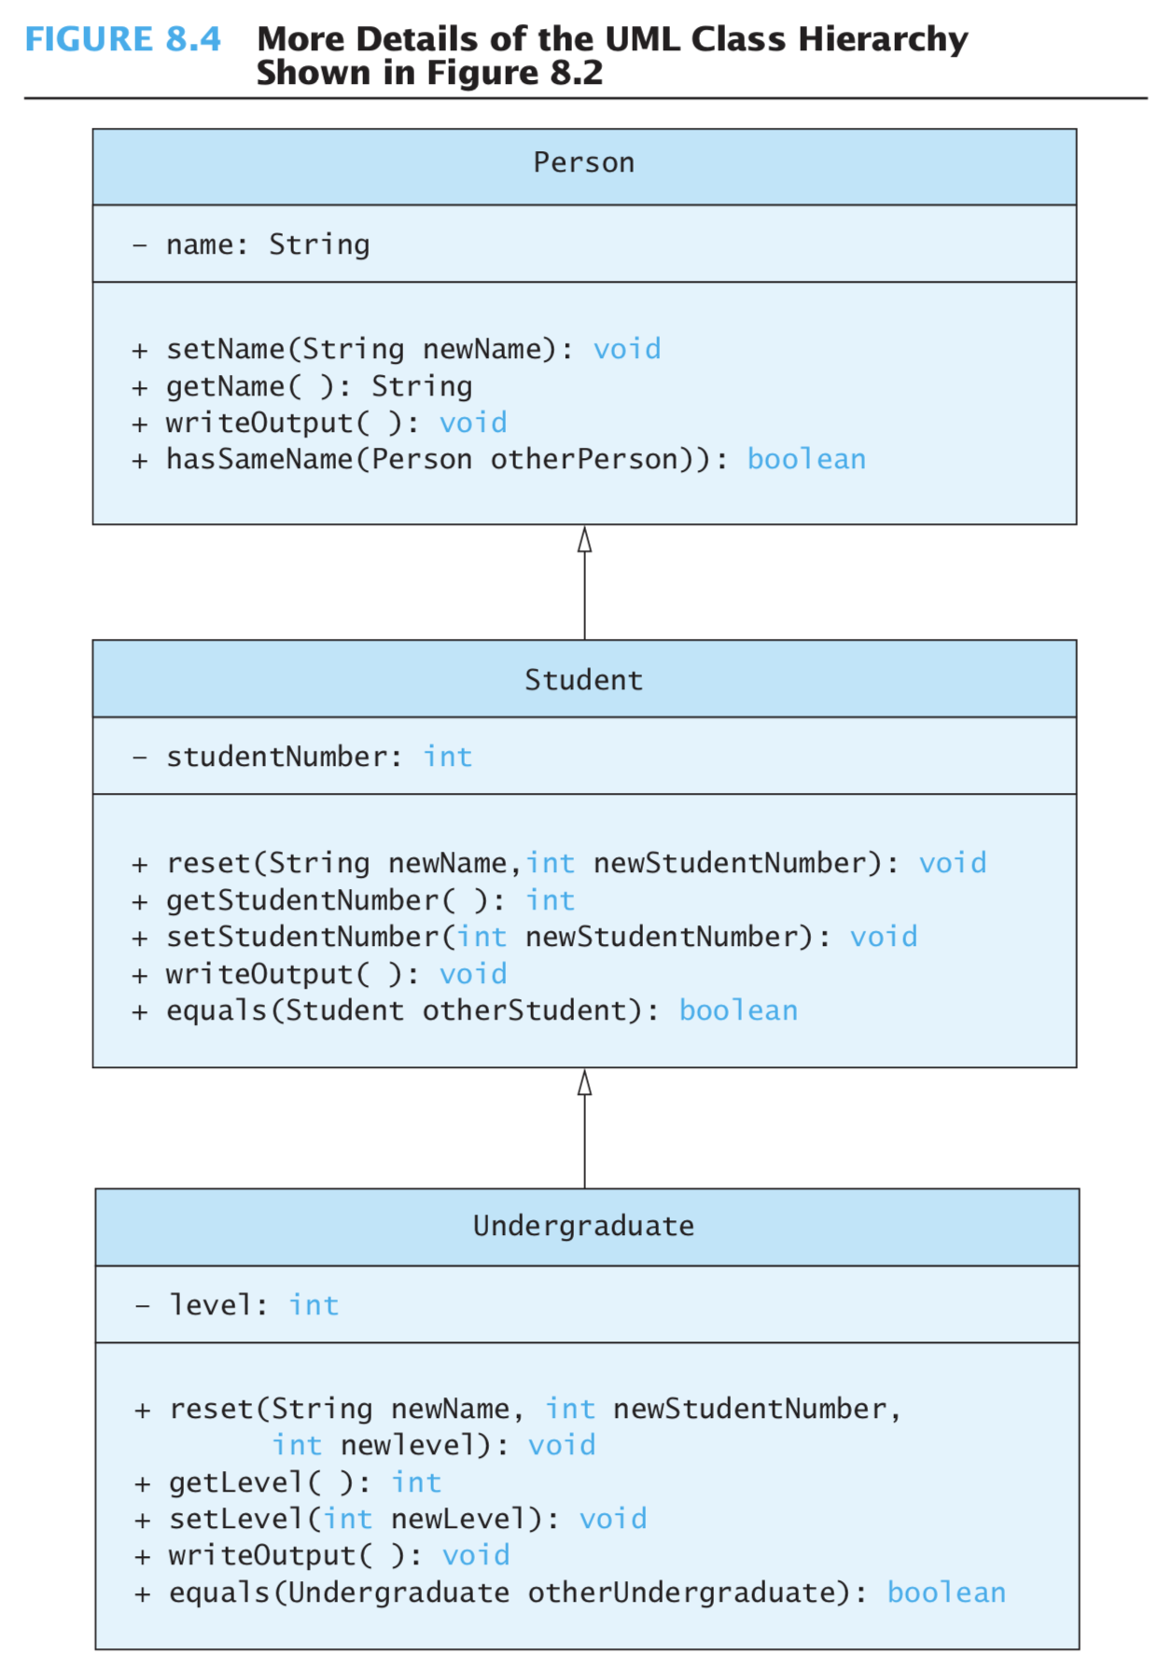

Slide 8
Citings:
Walter Satvich, Introduction to Problem Solving and Programming. 6th edition
Class notes- Spring 2018 JAVA 111B.
Wikipedia-- kinda! -- https://en.wikipedia.org/wiki/Class_diagram

